Slide 1

BluSolar

Slide 2
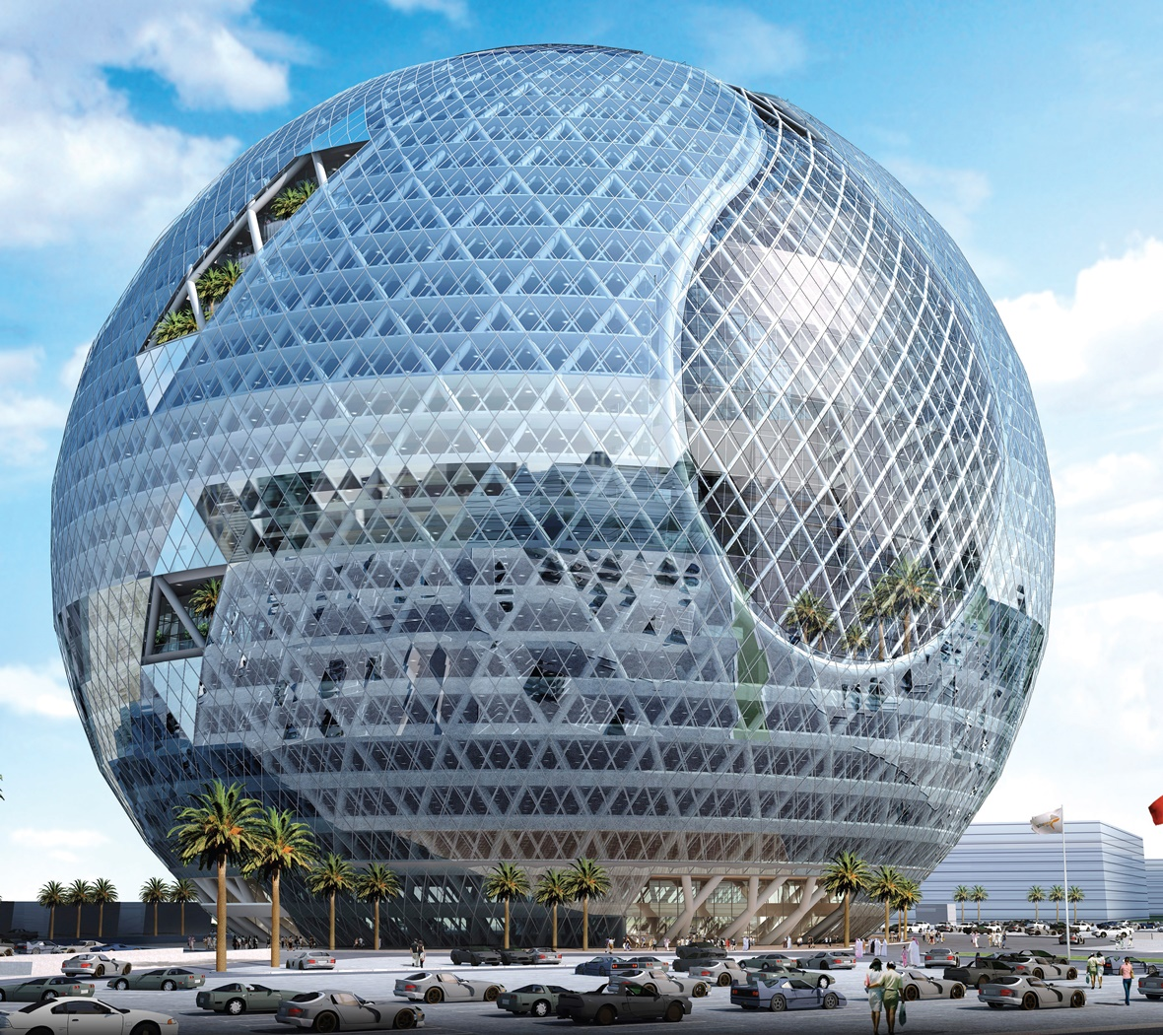

Imagine a future where entire buildings are covered in solar cells
BluSolar
2

Slide 3
However, BIPV faces challenges
BluSolar
Efficiency
Transparency
Durability
Light absorption in the infrared spectrum
Transparent enough to be a window, yet absorbent enough to be a solar panel
Lifetime of the solar cells within the windows
1
2
3
3

Slide 4
However, BIPV faces challenges
BluSolar
Efficiency
Transparency
Durability
Light absorption in the infrared spectrum
Transparent enough to be a window, yet absorbent enough to be a solar panel
Lifetime of the solar cells within the windows
1
2
3
4

Slide 5
Our Solution
5

Slide 6
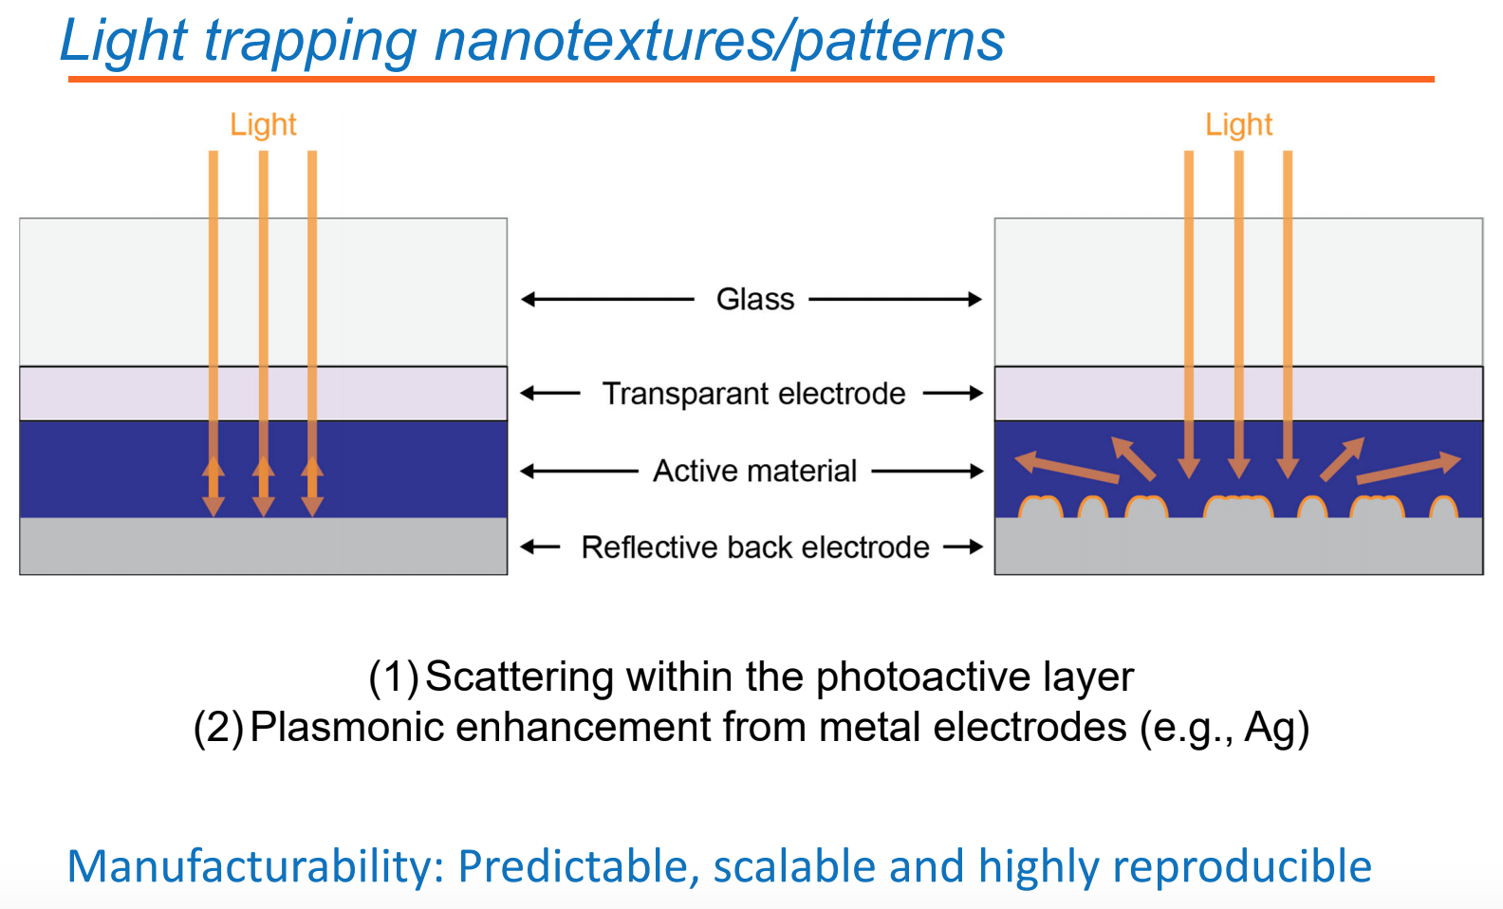
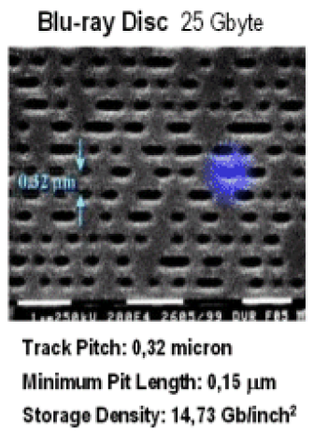
Nanotechnology can improve BIPV efficiency
BluSolar
6

Slide 7
Our Value Proposition
BluSolar
Greater Market Viability
BIPV with greater efficiency and cost-competitiveness will perform better in the market
03
Higher Efficiency (25-30%)
Nanostructure integration will increase the efficiency of BIPV by enabling greater light absorption
02
Greater Cost-Competitiveness
Higher efficiency will enable BIPV to be more cost-competitive when compared to other options of similar cost, lower efficiency, and limited applicability
01
7
Notes:
Value Proposition:
Which one of our customer’s problems are we helping to solve?
Solar efficiency and long-term viability
In the case of OPV, their two main problems are relatively low efficiency (20%) and durability.
Our product could address the efficiency problem in the OPV industry, possibly capable of increasing OPV efficiency by 20%.
What value do we deliver to the customer?
Increased efficiency
Increased market viability
Increased cost-competitiveness

Slide 8
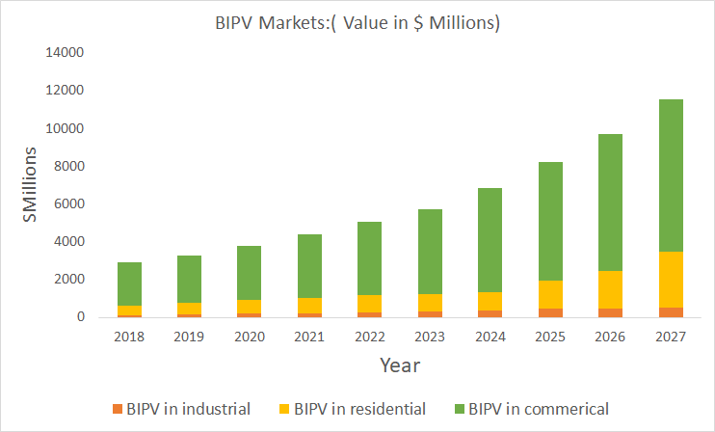
The BIPV market is growing rapidly
BluSolar
Growth rate: 12%
Market size: $3.7 Billion
Source: Ntech research
8
Notes:
The choice of BIPV
We believe that the growth rate is high
THe

Slide 9
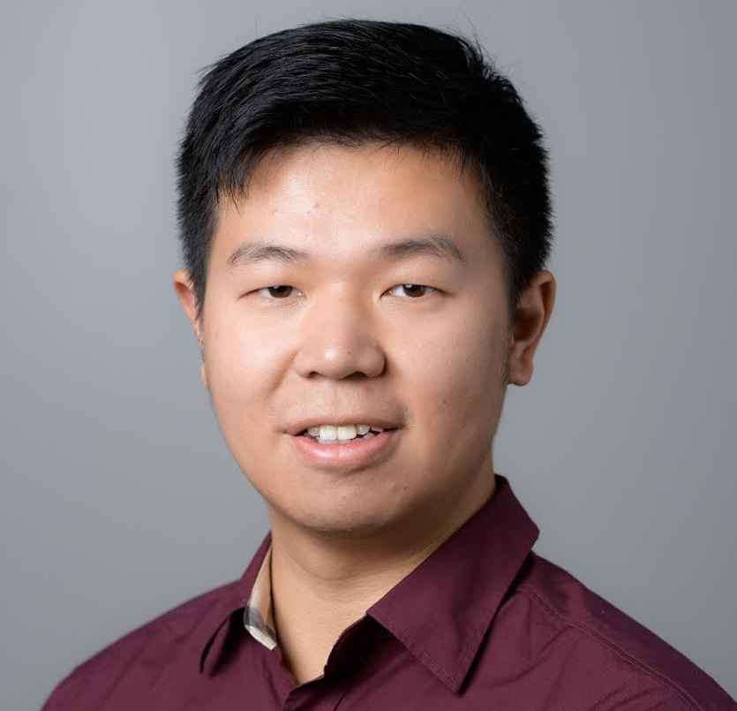

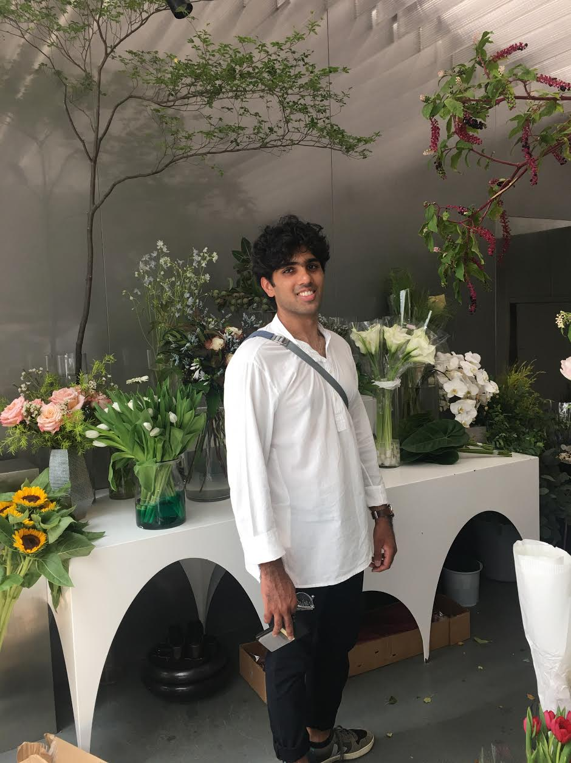

Blu Solar Team
BluSolar
Aran Mehta
Entrepreneurship
Minor
Esteban Panaget
Entrepreneurship
Minor
Shitong Xiong
Graduate
Engineering Mgt.
Sangram Rout
Graduate Mechanical Engineering
9

Slide 10
BluSolar
BluSolar
Contact : blusolar.info@gmail.com
10
Notes:
Leverage our strategy
Leverage license Resource and technology who supply our technology for license
Build the machine directly to the manufacturer
BIPV Solar panel manufacturers

